Slide 1
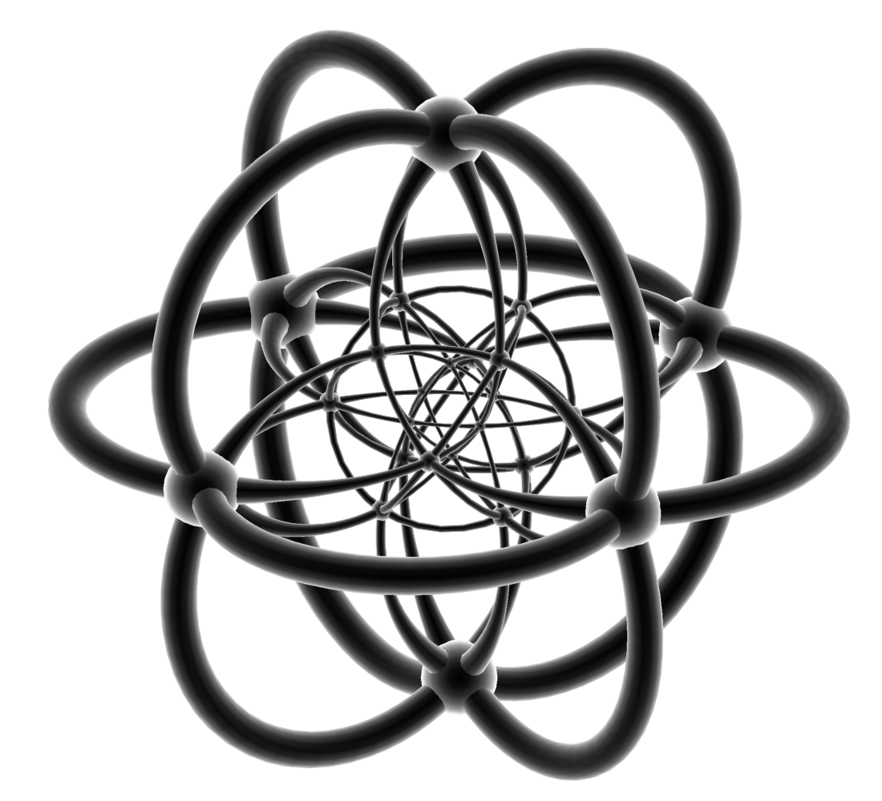

AUM $Mατh Clμβ$
MATH CHARADES
Friday, February 17, 2017
1:00pm – 2:00pm
Goodwyn Hall Room 204
Come Join the Fun:
We will be playing Math Charades – a competitive math game between two teams. The goal is to correctly guess the mathematical concept that a specified teammate is acting out!
Open and free to all AUM students and faculty
Snacks and refreshments provided

